Slide 1
WEB DEVELOPMENT
INDUSTRIAL TRAINING ON
PRESENTED BY~~
SARVESH KUMAR SHARMA(181500625)

Slide 2
Content
Company profile
Objective
Web development
What is a Website?
HTML
CSS
PHP
Project E-store

Slide 3
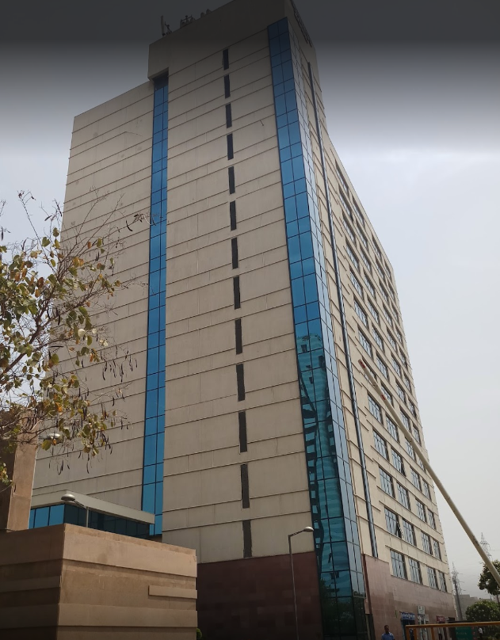
INTERNSHALA
COMPANY PROFILE
An Overview
An internship and online training platform, based in Gurgaon, India.
Founded by Sarvesh Agrawal, an IIT Madras alumnus, in 2010.
started out as a WordPress blog that aggregated internships across India and articles on education, technology and skill gap.
Internshala launched its online trainings in 2014.
As of 2018, the platform had 3.5 million students and 80,000 companies.

Slide 4
COMPANY PROFILE
Aim
On a mission to equip students with relevant skills & practical exposure through internships and online trainings with a vision of world full of freedom and possibilities.
A world where one can discover one’s passion and turn it into their career.
A world where you graduate fully assured, fully confident, and fully prepared to stake claim on your place in the world.
PRODUCTS AND SERVICES
Internship and job posting
Internship and job search
Internshala Trainings

Slide 5
OBJECTIVE
The Online Web Development Training by Internshala is a 6-weeks training program in the fields of HTML, CSS, and Bootstrap with an aim to:
Learn how to create a website from scratch.
Learn HTML & CSS to build structure of web pages and to style them.
Learn to use Bootstrap to develop responsive mobile web pages.

Slide 6
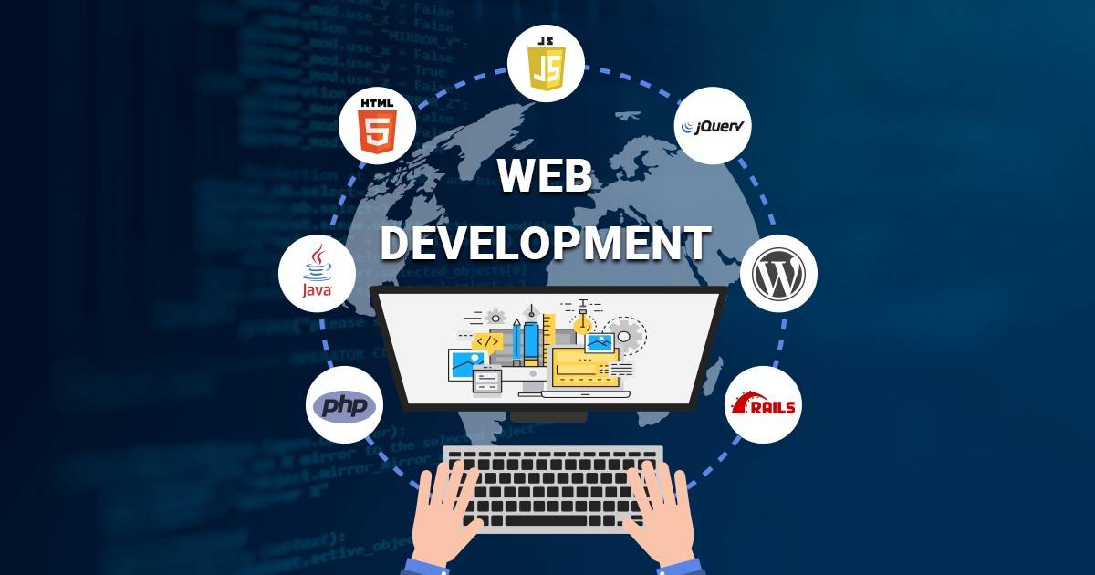
What is Web Development?
Usually refers to the main non-design aspects of building Web sites: writing markup and coding.
Web development is the work involved in developing a Web site for the Internet.
There are three kinds of Web developer specialization:
front-end developer
back-end developer
full-stack developer
Front-end developers are responsible for behavior and visuals that run in the user browser
back-end developers deal with the servers.

Slide 7

What is Website?
A collection of web pages and related content that is identified by a common domain name and published on at least one web server.
Websites are typically dedicated to a particular topic or purpose, such as news, education, commerce, entertainment, or social networking. Hyperlinking between web pages guides the navigation of the site, which often starts with a home page.

Slide 8

HTML
Stands for Hypertext Markup Language.
is the standard markup language for documents designed to be displayed in a web browser.
It can be assisted by technologies such as Cascading Style Sheets (CSS) and scripting languages such as JavaScript.
HTML describes the structure of a web page semantically.
With HTML constructs, images and other objects such as interactive forms may be embedded into the page.

Slide 9
CSS
Stands for Cascading Style Sheets.
a style sheet language used for describing the presentation of a document written in a markup language like HTML.
CSS is designed to enable the separation of presentation and content, including layout, colors, and fonts.
consists of a list of rules. Each rule or rule-set consists of one or more selectors, and a declaration block.
elements specified by attribute, in particular:
id: an identifier unique within the document
class: an identifier that can annotate multiple elements in a document

Slide 10

BOOTSTRAP
a free and open-source CSS framework directed at responsive, mobile-first front-end web development
contains CSS- and (optionally) JavaScript-based design templates for typography, forms, buttons, navigation, and other interface components.
focuses on simplifying the development of informative web pages.
provides basic style definitions for all HTML elements.

Slide 11

PHP
PHP is an acronym for "PHP: Hypertext Preprocessor“
a general-purpose scripting language that is especially suited to web development.
PHP code is usually processed on a web server by a PHP interpreter implemented as a module.
can be deployed on most web servers on almost every operating system and platform, free of charge.

Slide 12
E-STORE WEBSITE
PROJECT ON
USING HTML, CSS, BOOTSTRAP And PHP

Slide 13

PROJECT OBJECTIVE
The main goal of this PROJECT is to develop an easy to use web-based interface where Customer can search for products (Smartphones), view a complete description of the product and order the product.
Practical Implementation of learnt technologies.

Slide 14

SCOPE
Scope of this project is very broad in terms of other manually functioning.
It can be used by user to get information about the latest smartphones and buy them.
It can used for corporate world person to sell their products.
It is based on web application we can easily access it from anywhere.

Slide 15
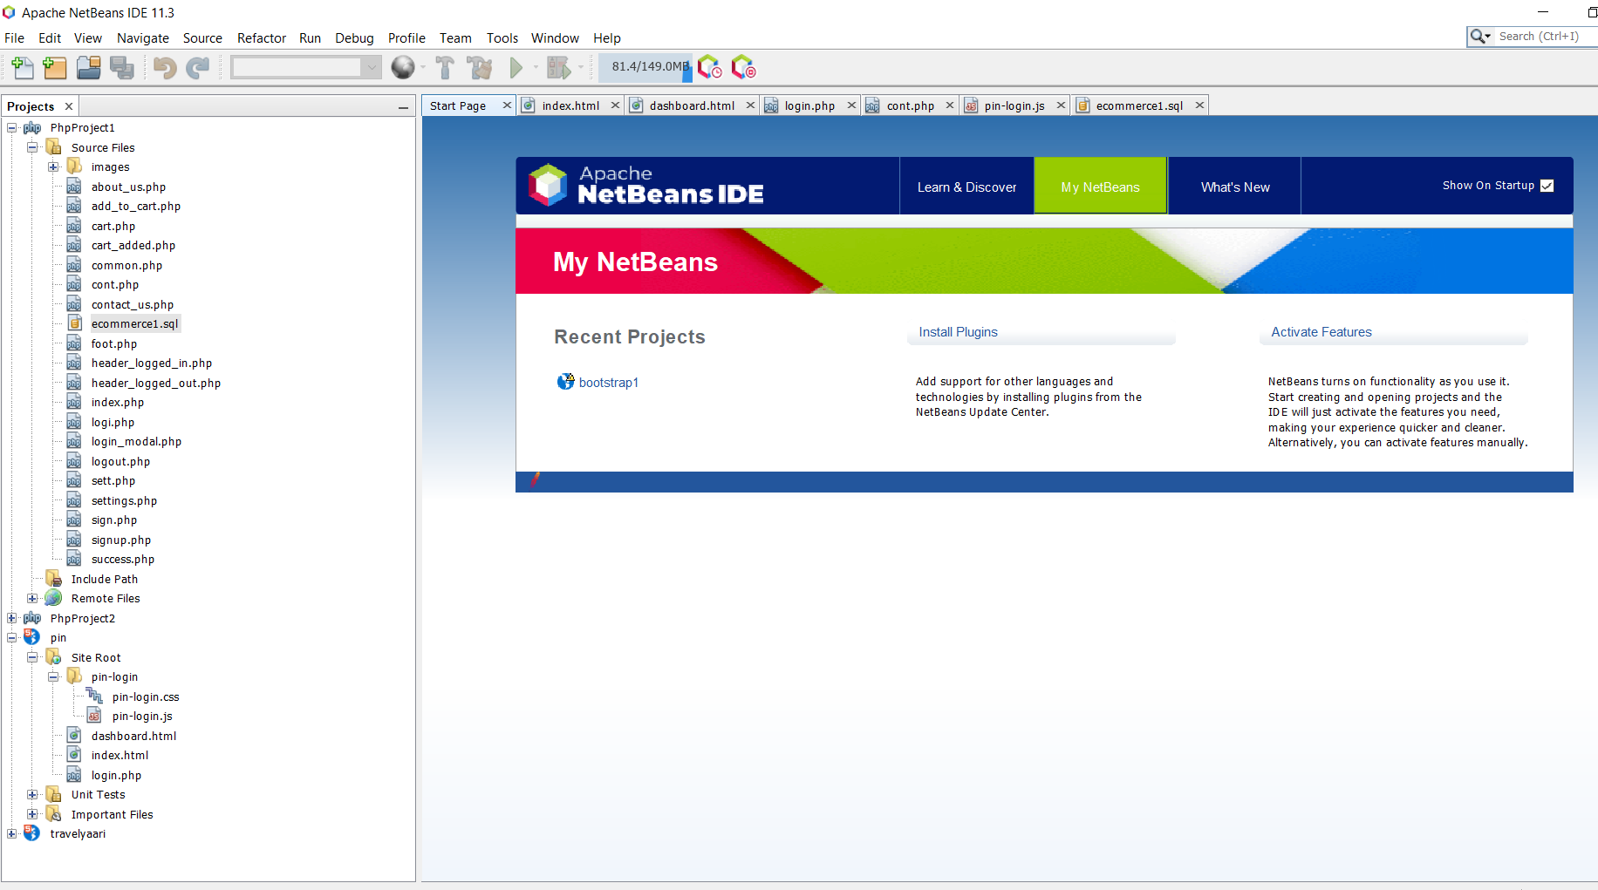
TOOLS
NETBEANS

Slide 16
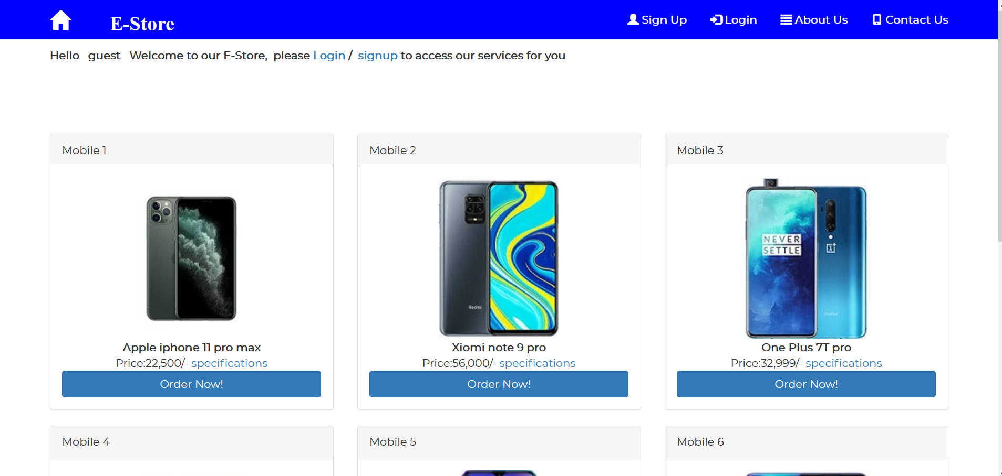
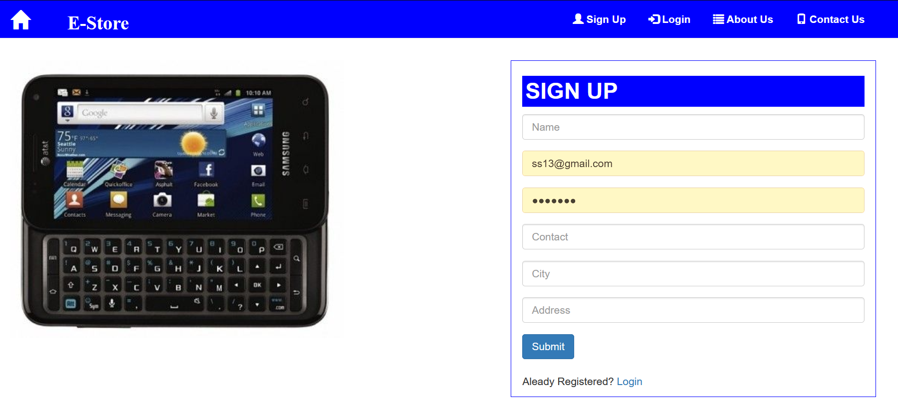
PROJECT SCREENSHOTS
HOME PAGE
SIGNUP PAGE

Slide 17
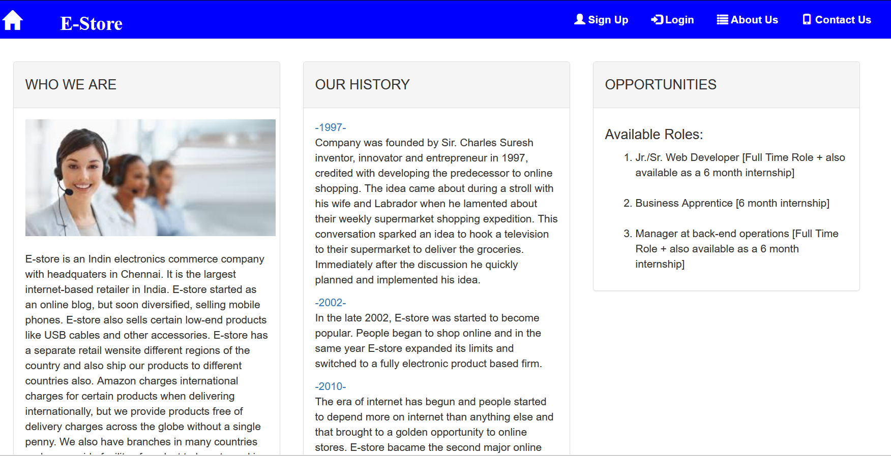
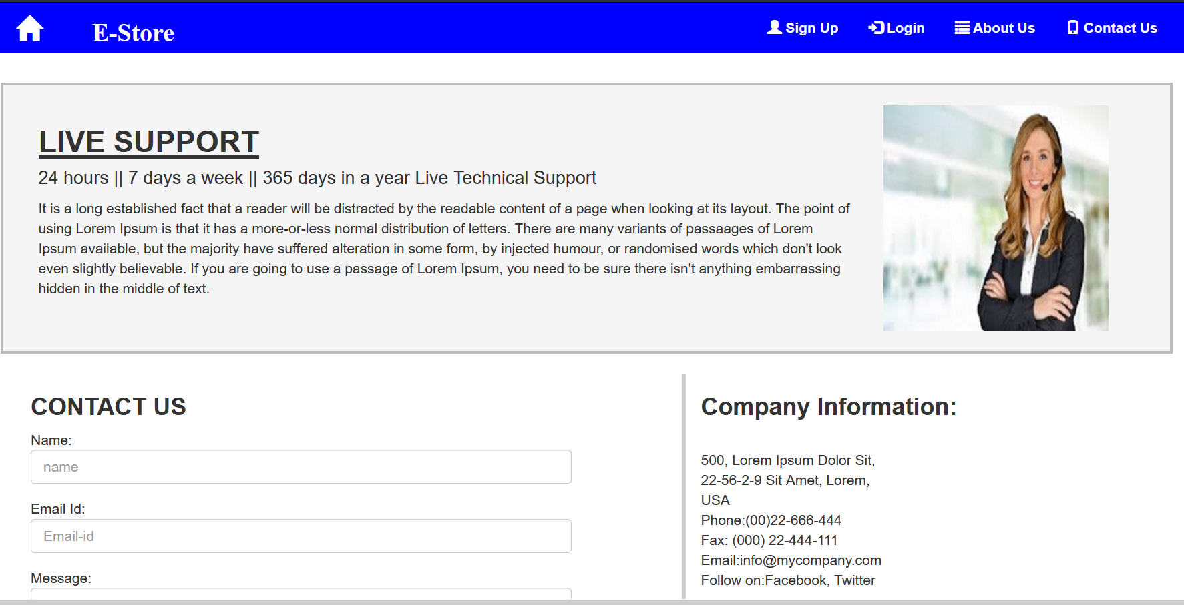
ABOUT US PAGE
CONTACT PAGE

Slide 18
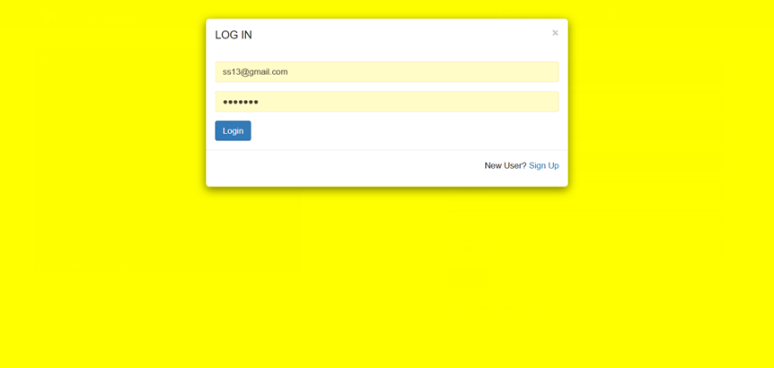
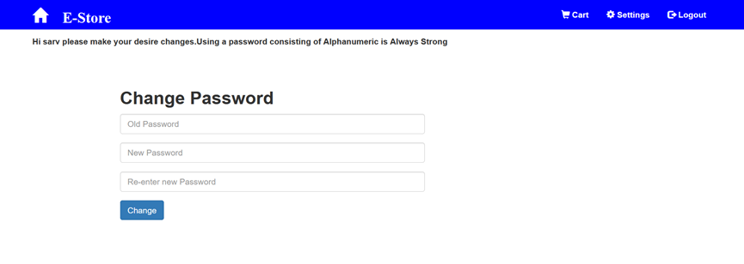
LOGIN
SETTING PAGE

Slide 19
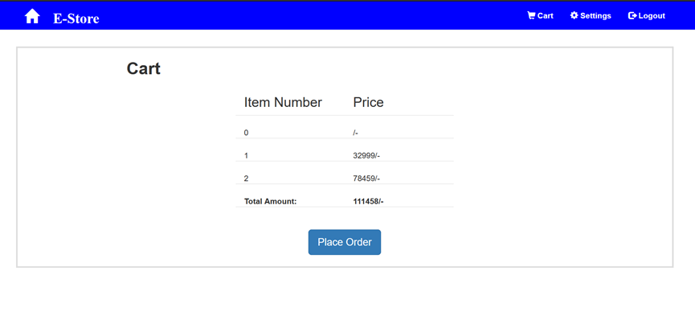
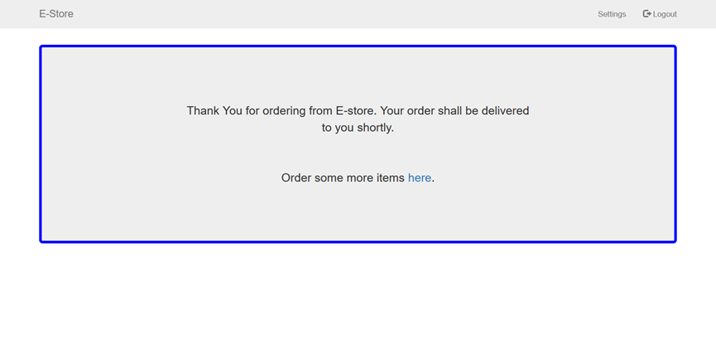
CART PAGE
SUCCESS PAGE

Slide 20


